Slide 1
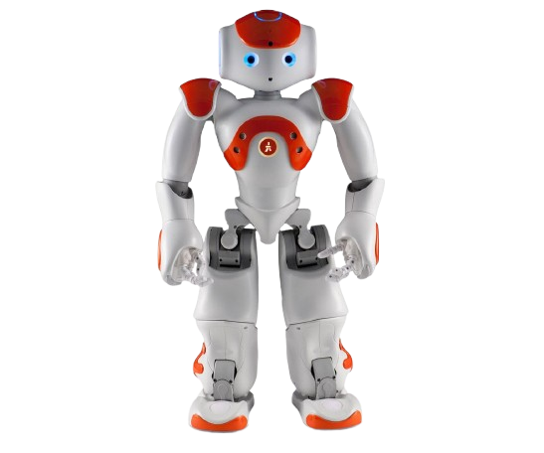
NAO OR NEVER
Team members:
Pietro Menotti and Lorenzo Moscardini

Slide 2


MOVES
Mandatory_moves =
[StandInit, Sit, Wipe Forehead,
Hello, SitRelax,
StandZero, Crouch]
Possible_intermediate_moves =
[Diagonal_left, Diagonal_right, Stand_from_sit, Move_backward, Move_forward, AirGuitar, ComeOn, Dab, DanceMove, PulpFiction, TheRobot, Mani_sui_fianchi, Ballo_braccia]

Slide 3
OUR STRATEGY (I)
Chosen algorithm: Iterative deepening search
Non informed search strategy
Combines the advantages of depth and breadth-first strategies
It is complete and explores a single branch at a time
Selection from random sample of possible intermediate positions

Slide 4
OUR STRATEGY (II)
STARTING FROM AIMA LIBRARY:
Class Choreography represents a segment of the global
choreography between 2 mandatory moves, modeled
as a subclass of AIMA’s Problem.
In the main() function, the global choreography is built through the iteration of sub-choreography generation

Slide 5
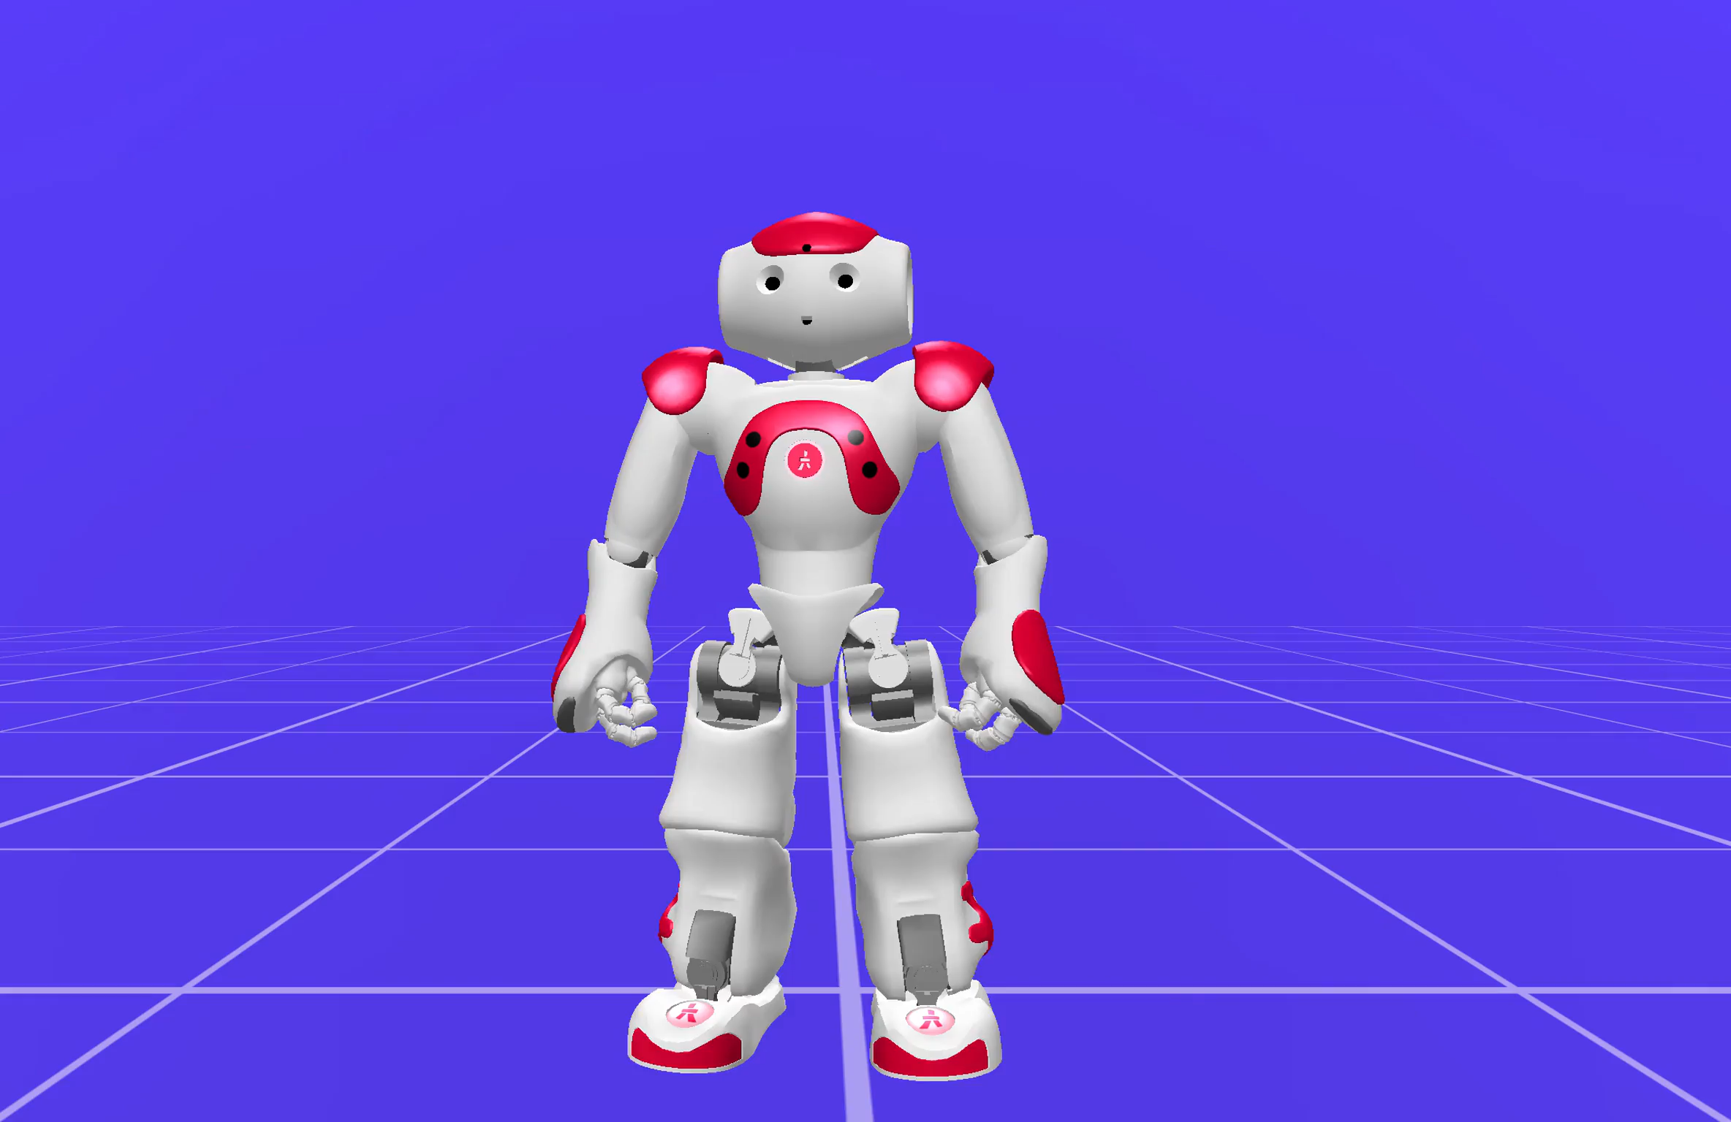
OUR CHOREOGRAPHY

Slide 6
THANK YOU and… LET’S DANCE!

